Slide 1
OPINION MINING BASED FAKE PRODUCT REVIEW MONITORING AND REMOVAL SYSTEM
Shivathmaj Shenoy M
4CB18CS085

Slide 2
Agenda
Overview
Working of Fake Review detection
Fake Review Survey Using Machine learning Approach
Fake Review detection Using Naïve Bias
Fake Review detection Using Random Forest Classifier
Fake Review detection using Decision tree
Scope of Growth and Disadvantages
Conclusion
Reference

Slide 3
Overview
The reviews on a product may be positive or negative, the negative reviews will attract the customers more than a positive review. These fake reviews can affect any business which leads financial profit or loses.
Due to the financial reasons many fake reviews will be appeared in these websites. The company owners will intentionally motivate some of the people to write the fake reviews to improve their business towards another product.
The focus of this research is to create an environment of online E-commerce industry where consumers build trust in a platform where the products they purchase are genuine and feedbacks posted on these websites/applications are true
So our Final aim in this is to implement best approach available for detection of fake reviews using opinion mining (sentiment analysis) techniques. To let users, know if each individual review is trustworthy or not for efficient use of money from users side.

Slide 4
Working of Fake Review detection
Preprocessing
Dataset
Feature Extraction
Model Training

Slide 5
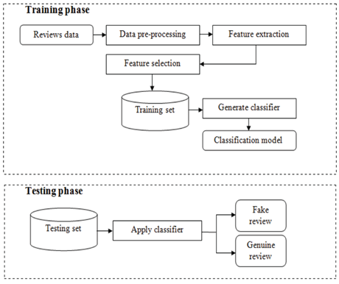
Fake Review Survey Using Machine learning Approach
Figure 3.11: Machine Learning based Fake Review Detection

Slide 6
Fake Review Survey Using Machine learning Approach
World Wide Web has drastically changed the way of sharing the opinions. Online reviews are comments, tweets, and posts, opinions on different online platforms like review sites, news sites, e-commerce sites or any other social networking sites
1. Untruthful reviews
2. Reviews on brands
3. Review Centric Approach
4. Centric Approach
5. Product Centric Approach

Slide 7
Fake Review Survey Using Machine learning Approach
Data Collection
Data pre-processing
Feature Extraction and selection
Classifier model construction and testing

Slide 8
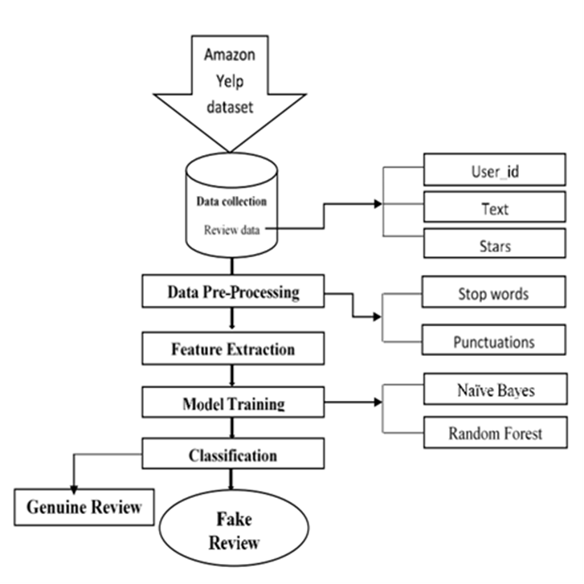
Working of Fake Review detection
Figure 3.1: Model Diagram for fake review detection

Slide 9
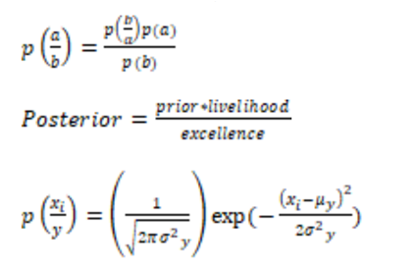
Fake Review Detection Using Naïve Bias
Figure 3.3: Naïve Bias Equation

Slide 10
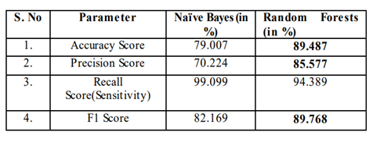
Naïve Bias Vs. Random Forest Classifier
Figure 3.4: Model Diagram for fake review detection

Slide 11
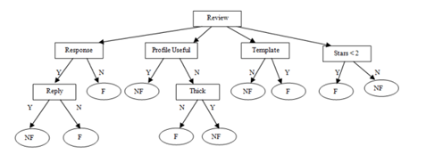
Fake Review detection using Decision tree
Figure 3.6: Machine Learning based Fake Review

Slide 12

Application:

Slide 13
Scope of Growth and Disadvantages
No Fixed Algorithm we need to choose a Algorithm based on Criteria and this is a manual task
In future work, hybrid models and new models can be tried for the fake review detection model.
Process is slow we can increase its speed by using Graphical Processing Unit
Need for constant evolution of methods because humans always find smarter ways to cheat the system

Slide 14
Conclusion
Identifying fake reviews from a large dataset is challenging enough to become an important research problem. Business organizations, specialists and academics are battling to find the best system for opinion spam analysis.
The most important part of an algorithm is its efficiency. Efficiency is not just about execution time. The efficiency of an algorithm is about the time taken for training the model and the time taken for the prediction

Slide 15
Reference
[1]. Dhairya Patel, Aishwerya Kapoor and Sameet Sonawane “Fake review detection using opinion mining” International Research journal of Engineering and technology (IRJET) , volume 5, issue 12,Dec 2018.
[2]. Jitendra kumar Rout, Amiya Kumar Dash and Niranjan Kumar Ray “Framework for Fake Review Detection: Issues and Challenges” IEEE Xplore ISBN:978-1-7281-0259-7/18 2018.
[3]. Nidhi A. Patel and Prof. Rakesh Patel “A Survey on Fake Review Detection using Machine Learning Techniques” IEEE Xplore ISBN: 978-1-5386-6947-1/18 2018.
[4]. Sanjay K.S and Dr.Ajit Danti “Detection of fake opinions on online products using Decision Tree and Information Gain” IEEE Xplore ISBN: 978-1-5386-7808-4 2019.
[5]. Syed Mohammed Anas and Santoshi Kumari “Opinion Mining based Fake Product review Monitoring and Removal System” IEEE Xplore ISBN: 978-1-7281-8501-9 2021.

Slide 16
THANK YOU

